Slide 1
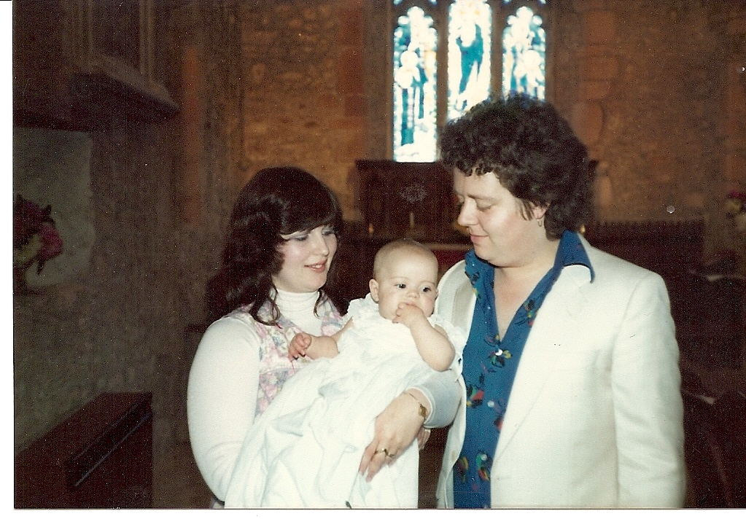
“I would like if I may.....to take you on a strange journey” The Rocky Horror Picture Show. This is the truth of my last 4 years! Many moons ago my mummy fell in love with homeopathy. Due to her love and passion this passed across to me. My biggest THANK YOU goes to my mum for without her, I would not be here today, literally! “I am who I am today because of the choices I made yesterday” Eleanor Roosevelt.
Davey pops, without you none of the last 4 years would have been possible! I don't know quite how you have stuck by me sometimes, but you have and I love you, for you have given your all to make sure that I am here today. Thank you. x My little people, you are wonderful and the cause to carry on has always been you guys. We have had a bumpy ride to get here today, but the two things that have been constant is our love and homeopathy! Sometimes I don't feel like they are different at all!
Mandy, thank you for supervising me over the last two years, your advice and wisdom has taught me so much. Lin, you're our very own angel! You have guided our family through the trickiest of times and have changed our lives. I really don't think I would be here today if it wasn't for you! Mike, Dion, Nicky and all the staff at CCH, the time and energy you give to educate is incredible. You have opened your lives and wisdom to help turn me and my year group into homeopaths, achieving our dreams and reaching our goals. It's because of you that homeopathy is able to reach more people than ever before. Thank you.
To my classmates, it's been fun, it's been hard, it's been a journey, where we have laughed and cried and always been there. I hope we can always be there to continue the fantastic support network. You are my homeopathy family and I love you all.
Elle

Slide 2
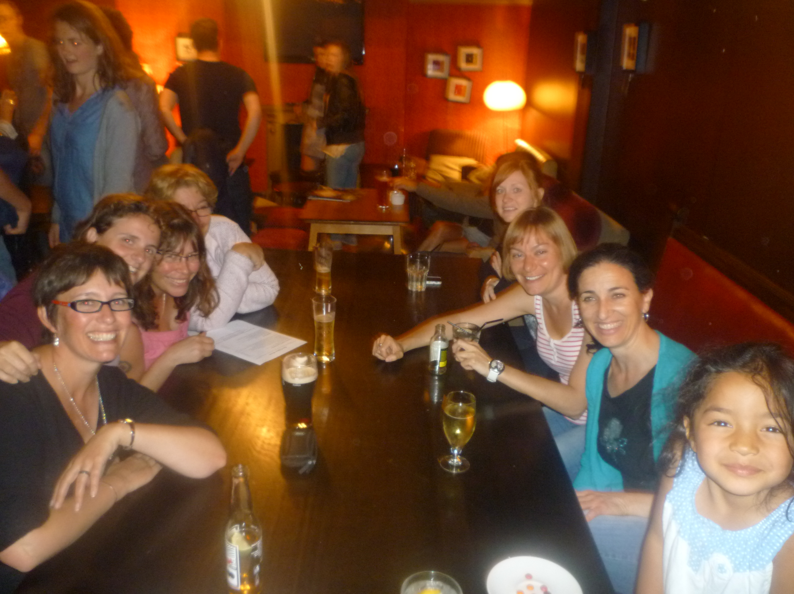
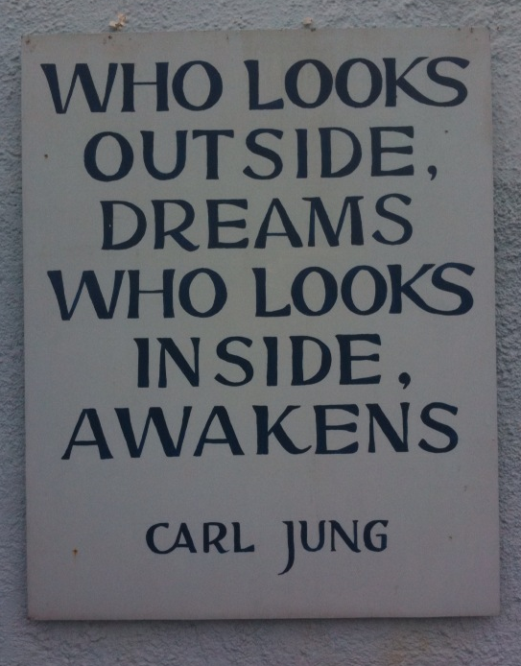
"Homeopathy cures a larger percentage of cases than any other form of treatment and is beyond doubt safer and more economical." Mahatma Ghandi
Paloma

Slide 3
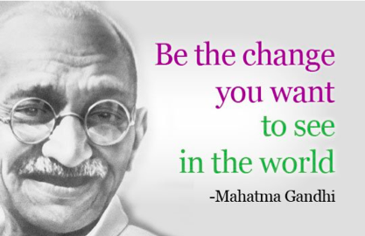
Good health, happiness, kindness and a better understanding of each other are the changes I want to see in the world.
My inspiring lecturers, my dear year group friends, my family and homeopathy have all helped me to be that change.
Kay

Slide 4
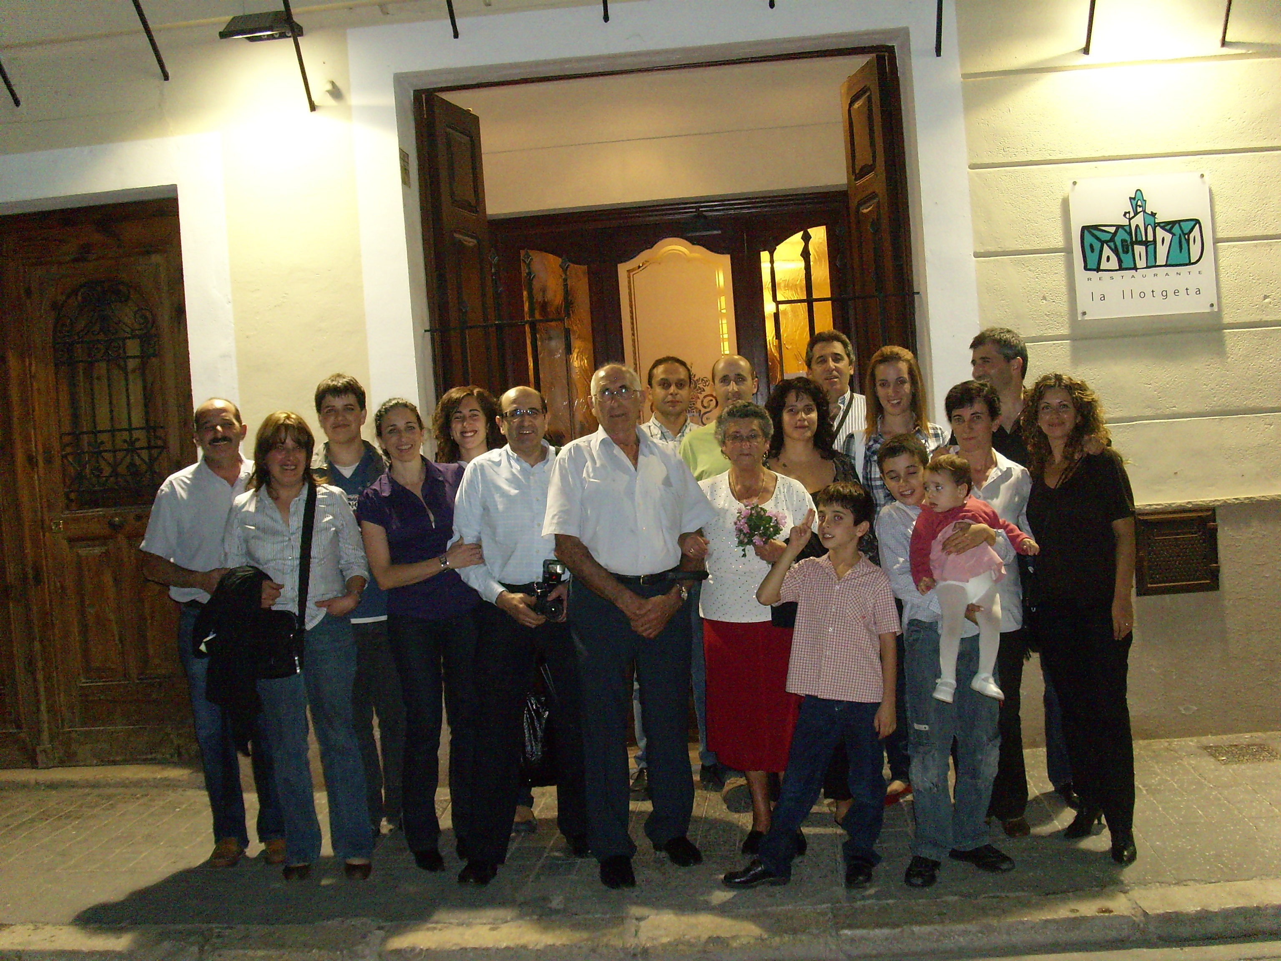
Don’t cry over what has happened in the past, but be happy that you could enjoy the moment
Chelo

Slide 5
When I came to College in 2009, homeopathy was just a part of my life.
In the 4 years here, I have experienced the most amazing homeopathic journey, through the treatment & remedies, through the college & the lecturers, through the fellow students who are now my friends. Thank you all at The Contemporary College of Homeopathy for contributing to my life & learning. I am very grateful for the support & love my family have shown me in the last 4 years, my precious children, my hugely supportive husband, my wonderful Mum, my family & my friends, who have all accepted my new ideas & concepts & allowed me to try out remedies on them. I could not have done this course without your support & I feel confident as a homeopath thanks to your belief in me.
Today, as I finish College in 2013, I realise homeopathy IS my life.
Shelley

Slide 6
Thank you…
To the lecturers for making college weekends so inspirational
To my wonderful classmates, you have made the past four years truly amazing, I'm going to miss you all immeasurably
To my mum for babysitting so that I could do my homework
To my children for being patient whilst mummy was at college
And most of all to my husband Grant for being so supportive xxx
Helen

Slide 7
The College of Homeopathy in Clifton has been really good fun and a pleasure to attend. The staff are wonderful and helpful, and I have made some life-long friends in my class.
I am very glad to get to the end of my studies and am looking forward to treating people.
Thank you
Simon

Slide 8
“The future is bright for holistic medicine as more people become aware of its power, its gentleness and its effectiveness in improving and maintaining health.” Stephen Gascoigne “The art of healing comes from nature and not from the physician. Therefore, the physician must start from nature with an open mind.” Paracelsus “Homeopathy shows you your truth.” Marcus Fernandez “Opportunities multiply as they are seized.” Sun Tzu
Massive Thanks to:-
Mike and the college team. My supervisors Nicky and Kate – I learnt so much from you both! My homeopath Nicky – what a journey! My fellow students – we did it!
To my husband Nigel and my daughter Bayli for all your unwavering support over the four years – couldn’t have done it without you!
Alice G

Slide 9
Huge thanks to the staff and my year group for the masses of support - especially during this last year - I shall really miss you all.
Thanks and hugs too for my friends and family, for encouraging me to keep going and follow my dream
x x x
Maggie

Slide 10
Through homeopathy
my suffering became my healing. I found this course and amazing people with generosity, kindness and wisdom. These people have given me the insight and the skills to practice homeopathy, and to turn the suffering of others into healing.
Through homeopathy I have found my path.
Alice B

Slide 11
… from the class of 2013

